Slide 1

D-Pad
Team-52

Slide 2


PROJECT GUIDE Dr. Nidhi Mishra

Slide 3
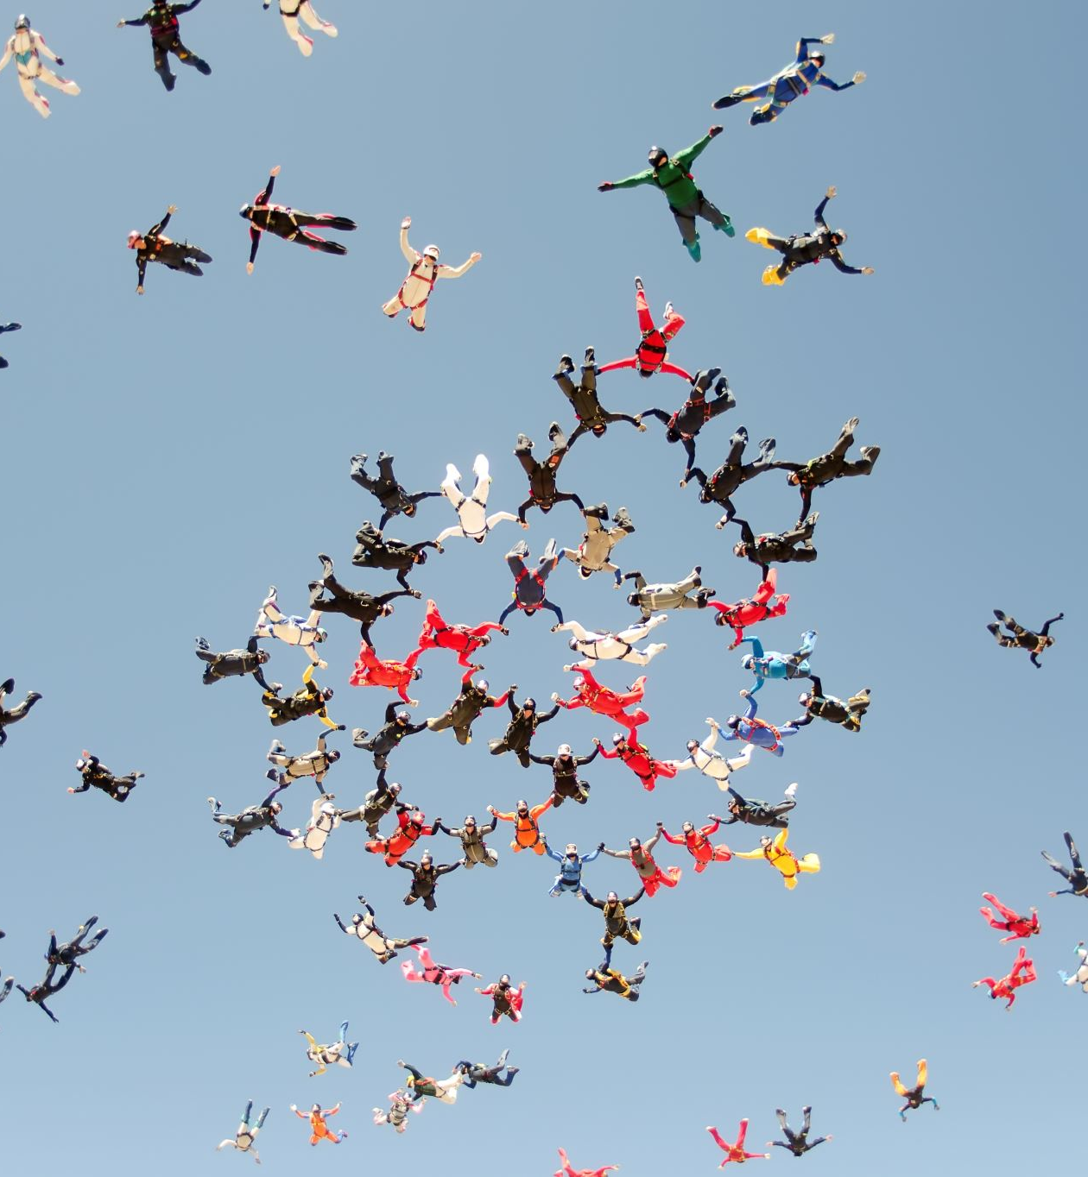
TEAM MEMBERS
Kanika(19BCE10165) - View Menu and Doodling feature
Soumya Singh(19BCE10159) - File Menu and creating dataset
Yash Thakkar(19BCE10388) - Edit Menu and creating dataset
Rishita Srivastava(19BCE10121) - Format Menu and complete execution of our text editor

Slide 4




INDEX
01. INTRODUCTION
02.EXISTING WORK WITH LIMITATIONS
03.PROPOSED WORK AND METHODOLOGY
04. NOVELTY OF THE PROJECT
05. REAL TIME USAGE

Slide 5
INDEX
06. HARDWARE AND SOFTWARE REQUIREMENTS
07.OVERALL SYSTEM ARCHITECTURE
08.LITERATURE REVIEW
09. MODULE DESCRIPTION
10. MODULE WORKFLOW EXPLANATION

Slide 6
INDEX
11. IMPLEMENTATION AND CODING
12. DEMO VIDEO
13. SNAP SHOTS
14. RESULT
15. CONCLUSION

Slide 7

INTRODUCTION

Slide 8

A text editor is a program that allows the user to open, view, and edit plain text files (files containing only text). They are essential to the world today.
Text editors deal with manipulating text and provide features to enhance the writing experience. The major functionalities of text editors are: inserting, deleting, and viewing text. Additional features are: find and replace, copy/cut and paste, text formatting, sentence highlighting, and etc.
With their relevance in every programming, sub-culture Text Editors tops the list since text-editor is the basic tool everyone uses.

Slide 9

The bare backbones of a text editor heavily relies on the data structures. Data Structures are used to add major functionalities and features in a text editor.
So we have decided to create a unique Text Editor D-Pad, by using various data structures like Gap buffer , Binary trees etc and java programming where users will be able to express their emotions while writing and add spice to their text by using a doodles enhancing the overall text and writing experience.

Slide 10

Existing Work With Limitations

Slide 11
There are a lot of text editors available. with functionalities like inserting, deleting, and viewing text and features like find and replace, copy/cut and paste, text formatting, sentence highlighting, and etc.
Many are very good and some are great. But sometimes, the most satisfying answer to any question is the one you build yourself.
Welcome to 2021, where doodles are among the most important tool while writing , But the existing text editors are only focussed only towards editing texts and does not include doodling features which becomes a major drawback of the existing text editors as people today urge and look for doodles graphical representations like graphs to express their thoughts while writing and present it in a better way.
Your mundane texts should include a doodle to add a dash of color or a blip of personality.It is important to emphasize our texts with our body language and facial expressions, but technological advances make that a difficult task.
However, emojis make the task less daunting and more comprehensible.

Slide 12

Proposed
Work And Methodology

Slide 13

Dpad is a Text Editor which will include File operations, Data structures and will be created in Java.
Dpad will consist of File Handling operations to save , edit, print and delete text documents.
Text editing in Dpad will be achieved by using data structures in functions like cut, copy, paste, undo and redo.
Dpad will have functions to change the Format of the text considering user preferences providing various Font-families, font-style, font-color and font-size accomplished by diverse inbuilt java libraries .

Slide 14
For user convenience and elevated options Dpad will include variety of view options allowing the user to set themes to the executable application, vary the size of the text in their document and for additional ease have a spell check functionality..
The methodology is that Dpad will be divided into 4 parts then executed individually, compiled and transformed into a functional website.

Slide 15

Novelty of the project
Dpad will have a featured doodle function enabling users to insert desired images in their documents furthermore providing users with pen like functionality to pour their imagination onto the pad.
On fruition, Dpad has a scope to transform the application into website enabling future expansion alongside extended improvisation and modification.

Slide 16

REAL TIME USAGE

Slide 17

Text Editor is not only related to programming but it is a software through which you can write or edit some text. As far as programming is concerned you have to write or code your programme in a text editor and then you have to compile your code using a compiler.
1) It can be used to pen down thoughts.
2)We can take notes in class for a lot of subjects when teachers are teaching in pace and we have to keep up or take the summary / important points.
3)Using doodle will enhance our writing experience and will make the notes more attractive and understandable.

Slide 18

Software and Hardware Requirements

Slide 19

Software :
For Text Editor:
Java IDE
Java Swing
Java AWT
Java UTIL
For Doodling:
Java SWT(Standard Widget Toolkit)
Google QuickDraw Dataset

Slide 20
Hardware:
Intel Pentium III cpu or higher
Windows 7 (32 or 64 bit) or above for full functionality
Internet Connectivity

Slide 21

Overall system architecture diagram

Slide 22










For Text related tools user gets handy features
Frontend
Access D-Pad
For inserting a doodle
Java Swing
Java AWT
Query
Stored Google QuickDraw Dataset
USER
File can be stored locally on the disk

Slide 23

LITERATURE REVIEW

Slide 24
The text editors which are present are based on the Keystroke-Level Model, with which to evaluate text editors on interactive computing systems. The authors claim that this methodology can also be applied to word processing. The authors believe that their evaluation technique is standardized, in that it measures the significant dynamics associated with using several different text editors of varying complexity and hardware implementation. They further claim that their measurement techniques is objective, through, and easy to use. This methodology is intended for use by text editor designers, word processing center managers, and other non psychologists who need to evaluate text editors, but who have limited time and equipment. It is this writer's opinion that, while the authors' methodology is objective and thorough, the requirements for trained personnel to (1) teach novice users, (2) perform accurate data collection, and (3) interpret the results of the study believe the authors' claim that the measurement techniques described in this paper would be human factors engineers and industrial psychologists, precisely the opposite audience for which the paper was intended.

Slide 25

MODULES
FILE
EDIT
FORMAT
VIEW
DOODLING

Slide 26

FILE MODULE
The main typing area has been included using JTextArea
File module consists of Open, Save , Print , Close.
The open function uses JFileChooser from the java swing library It an effective way to prompt the user to choose a file along with this we have also used JFileNameExtensionFilter which allow the user to choose and open files with only .txt extension .
We use JFileChooser to save the file in the desired directory.

Slide 27

EDIT MODULE

Slide 28
COPY/PASTE
Copy and paste functionalities use data structures like gap buffer and rope data structure.
The copy and paste commands are done using system calls. When copying or pasting the location of the file is saved onto “clipboard” that can hold small amount of data for a small period of time.
For copying and pasting texts, Queues are used where one can enqueue dequeue from the same end.
UNDO/REDO
undo and redo functionalities are made using stack .
The main idea behind current clipboard implementation is that the clipboard can only hold a single copy instance at a time.

Slide 29
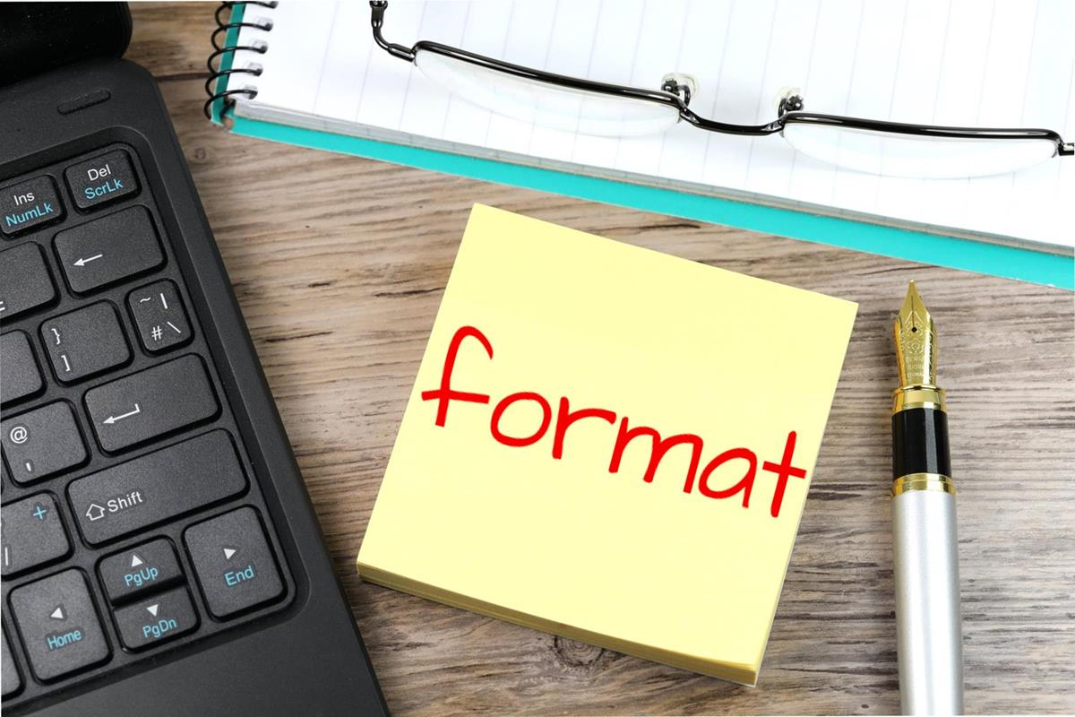

Slide 30

Formatting data may be qualitative (e.g., font family), or quantitative (e.g., font size, or color). It may also indicate a style of emphasis (e.g., boldface, or italics), or a style of notation (e.g., strikethrough, or superscript)
Few options that can be included are: font-style,normal,italic ,bold,font size, bullets and numbering,etc..
The java libraries that will be included
for the same will be:
1) java.awt.event.*
2) javax.swing.*
3) java.awt.*and few other.

Slide 31

VIEW MODULE
View module consists of Find/Replace , Spell Check, Zoom In, Zoom Out and Theme options .
For Spell Correction , we are using hash table, dictionary and JTextComponent from the Swing framework.
For Zoom in and Zoom Out we’ll use JPanel and implement the MouseWheelListener in order to detect when the user rolls the mouse.
For Find/Replace , we are using Swing, java.awt.event.ActionListener and Action Event which will use methods of JTextArea to perform actions.

Slide 32





SKETCHING DOODLES
For Sketching , we’ll use the package org.eclipse.swt.graphics contains classes that allows management of graphics resources.
The subclass org.eclipse.swt.widgets.Canvas has a number of style bits that can be used to affect how painting occurs.
Java GC has number of methods that allows to draw lines , shapes and text and fill colors.
We’ll be also using presaved dataset to search for doodles by typing it’s category.

Slide 33
Modlule Work Flow

Slide 34
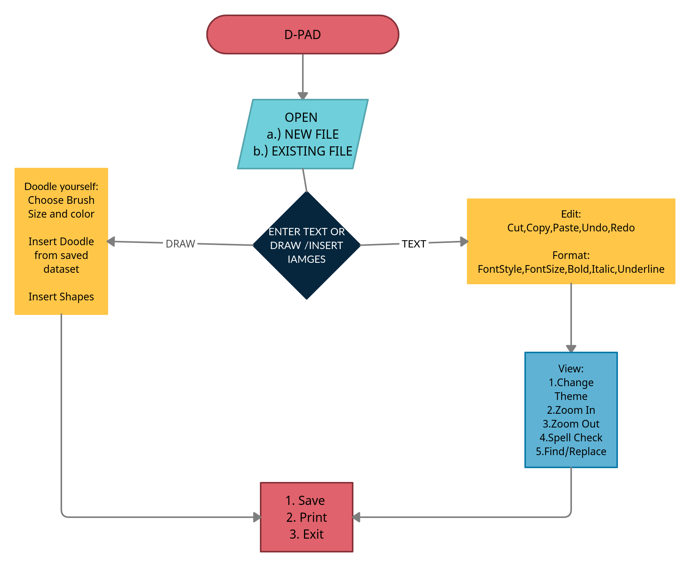

FLOW DIAGRAM

Slide 35
Module Split-Up
FILE HANDLING
VIEW OPTIONS
EDITING TOOLS
DRAWING TOOLS /INSERTING FIGURES
FORMATTING

Slide 36

MODULE DESCRIPTION

Slide 37
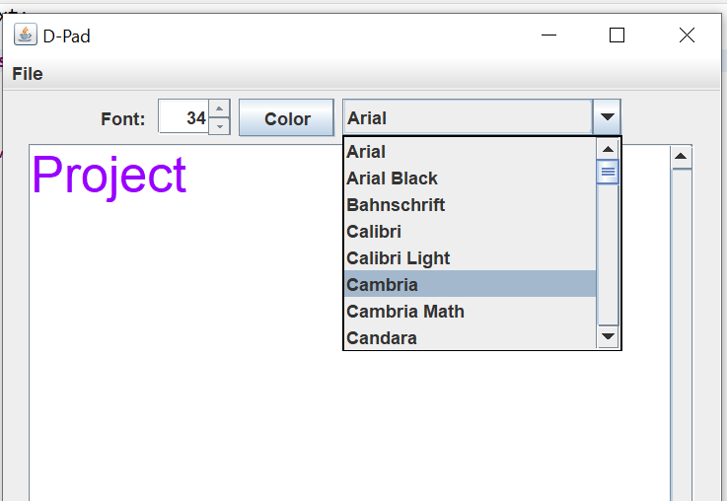

TEXT AREA-
The JMenuBar and JMenuItems from the Java Swing library have been used to create the menu bar and the menu items which consists of various text editing option and a draw tool button.
The JTextArea is used to create the complete typing area.
In this first we specified the size of the text area as 500*500 and used flow layout for the arrangement of the buttons and
used line wrap to avoid the usage of double scroll bars and make the text systematic.
FileChooser has been used in the open and save function in the file section.
JTextArea has been used to create the complete typing arera

Slide 38
FILE SECTION-
The object of JFileChooser class represents a dialog window from which the user can select file to either open a new file or save the created file in a specific directory.
In this we create an empty constructor that points to user’s default directory
JFileChooser(String) – uses the given path and then we locate our file through this path and open it.
To ensure that only .txt files are used we have used JFileNameExtentionFilter this sets the file filter and allows us to add only .txt file and HTML files.
at last we used JFrame.EXIT_ON_CLOSE to
set the default close operation

Slide 39
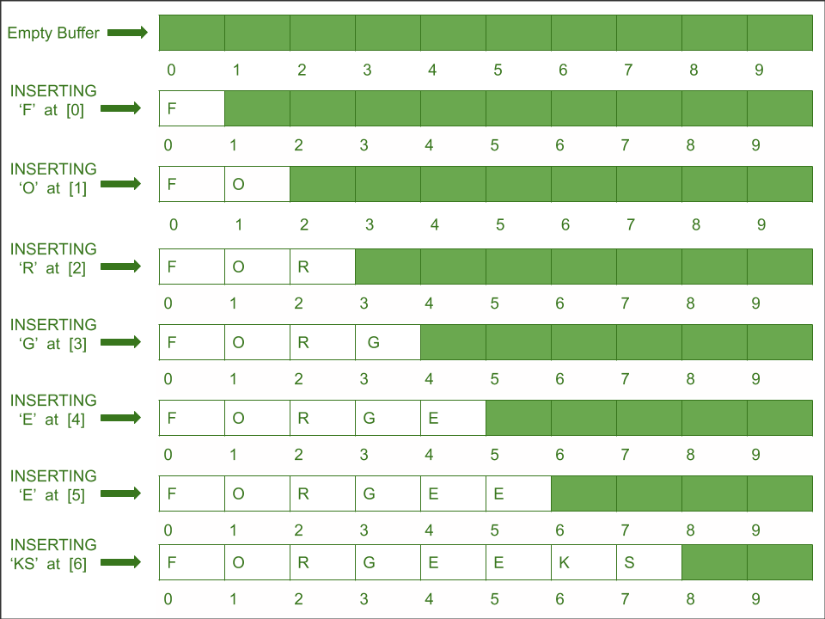
EDIT OPTION- COPY/PASTE/CUT
For copy , paste and cut functions we have used the JTextArea Library .
Copy/Paste functions use gap buffer data structure which is used for editing and storing text in an efficient manner that is being currently edited.

Slide 40
EDIT OPTION- COPY/PASTE/CUT/UNDO/REDO
Example: Consider an example with initial gap size 10, initially, array or gap are of the same size, as we insert the elements in the array similarly elements will be inserted in the gap buffer, the only difference is gap size reduces on each insert.
Basic operations in Gap Buffer
Insert:It first checks whether the gap is empty or not, if it finds that the gap is empty it calls procedure grow() and resizes the gap and now the element can be inserted.
Left : It is a procedure used for moving the cursor to left and this cursor point is used as position for changes.
Right : It is a procedure used for moving the cursor to right and this cursor point is used as position for changes.
Grow : It is a procedure used when the gap size has become zero and therefore we need to resize the array by inserting a gap at desired position.

Slide 41
EDIT OPTION- UNDO/REDO
For undo and redo functions we have used the UndoManager Library
Undo: Erases the last change made to the document
Redo: Restores the most recent UNDO operations performed on the document.
There are 2 stacks created , one each for undo and redo . Undo stack has a certain size in which last WRITE OPERATIONS encountered are stored.
When undo is encountered the last operation is popped from the undo stack and added to the redo stack.
If the user does a redo operation the top most element of the redo stack is popped and added to the undo stack.
There is a read operation involved which when encountered prints all the elements of undo stack in reverse order.

Slide 42
FORMAT
The JButton class is used to create a labeled button that has platform independent implementation. The application result in some action when the button is pushed. It inherits AbstractButton class. We have used JButton for font colour.
JComboBox is a part of Java Swing package. JComboBox inherits JComponent class . JComboBox shows a popup menu that shows a list and the user can select a option from that specified list . JComboBox can be editable or read- only depending on the choice of the programmer .We are using JComboBox for font box which is used for choosing the size of text.
We have created an array of strings to add all the the fonts used in our text editor.

Slide 43

FIND AND REPLACE
For Find and Replace, we are creating a Label with options to Find, FindNext,Replace,Replace all and cancel.
User can enter the text to be found and replaced in JTextField. After which, the index of entered text in Find will be looked and selected in JTextArea and then will be replace by method JTextArea.ReplaceSelection.

Slide 44

Spell-checker
For spell-checker, we're using our own dictionary.txt file .
So, first we'll insert all the words from the dictionary file into a hash table. Then we'll start reading the text entered by user in the JTextArea. If the user entered word exists within the hash table, then that word is spelled correctly.
Otherwise, it's again checked by removing all the punctuation characters.

Slide 45
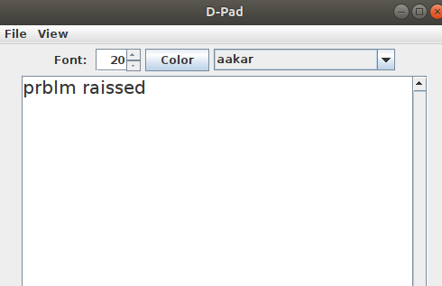
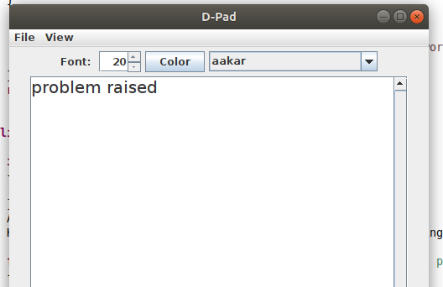
But if still the word is not found , then SpellingSuggest class is called which uses the EDIT DISTANCE method to suggest the most probable word for the error.
After the suggestion, we find the index of the wrong word and with the help of index we select the word in JTextArea and replace it by the suggested word.

Slide 46
Sketching Doodles:
Features Available:
Draw strokes with pencil tool and set thickness.
11 Quick color selection buttons.
Provided with Color Picker (Swatches, HSV, HSL, RGB, CMYK) using JColorChooser.
Small size, easy-to-understand code.
Save, Save As, Load buttons to Save/Load you work using Interactive JFileChooser.
Undo, Redo
Nimbus Look and Feel theme.
Set Canvas size. ( Minimum recommended: 900x800)
Enter Text

Slide 47
Inserting Pictures:
A JFrame appears with option to select from the categories provided in the JComboBox. When user selects the category and click on Search button , the available saved pictures appear on the Frame and user can select any of them.

Slide 48

IMPLEMENTATION AND CODING

Slide 49
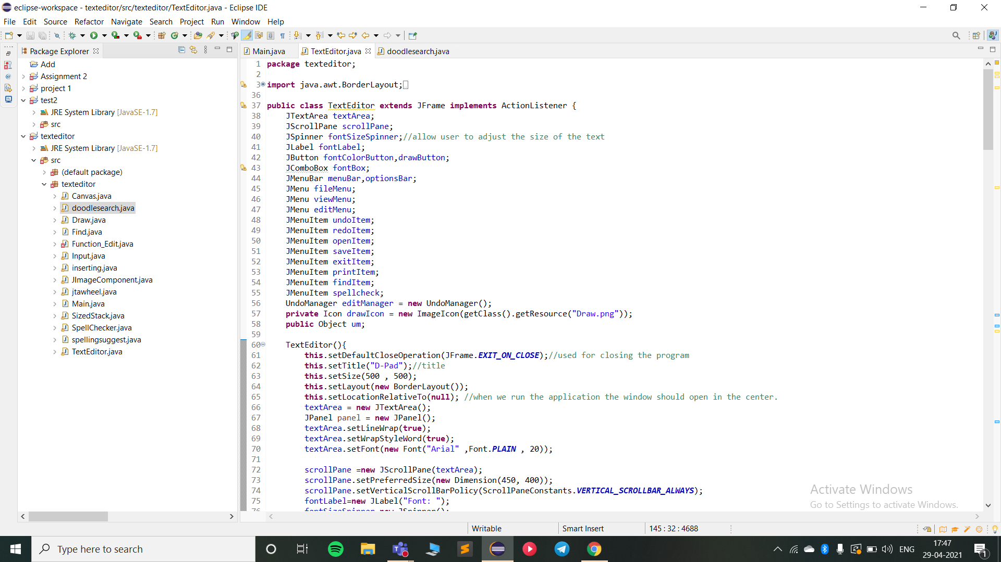

Slide 50
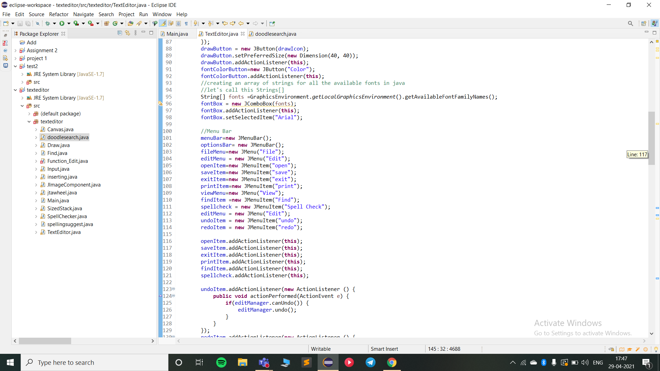
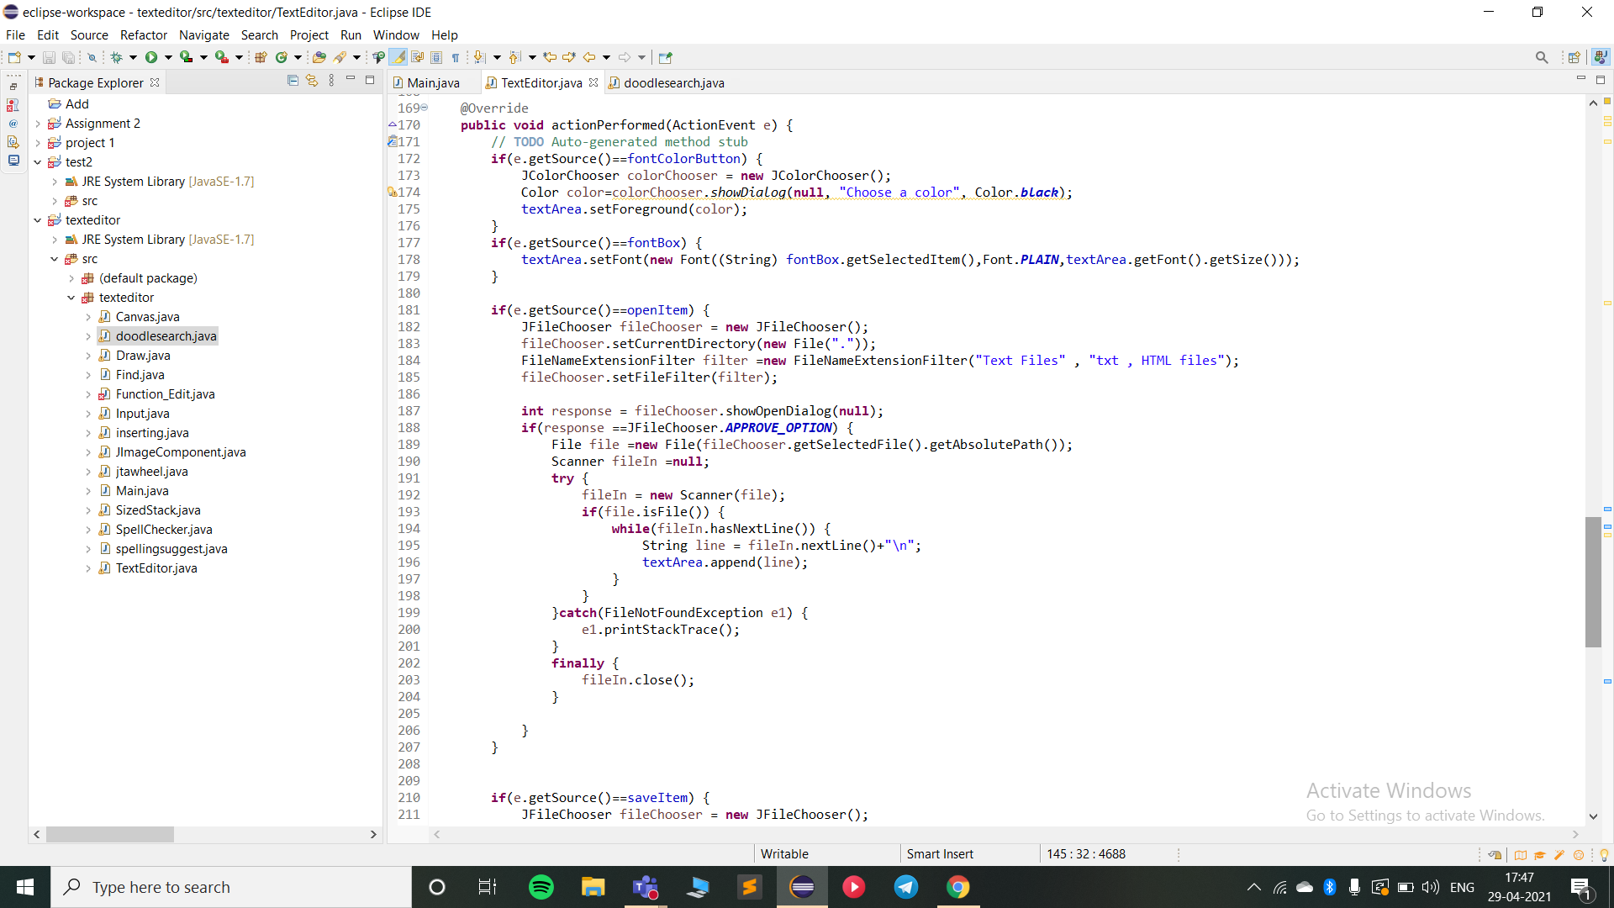

Slide 52
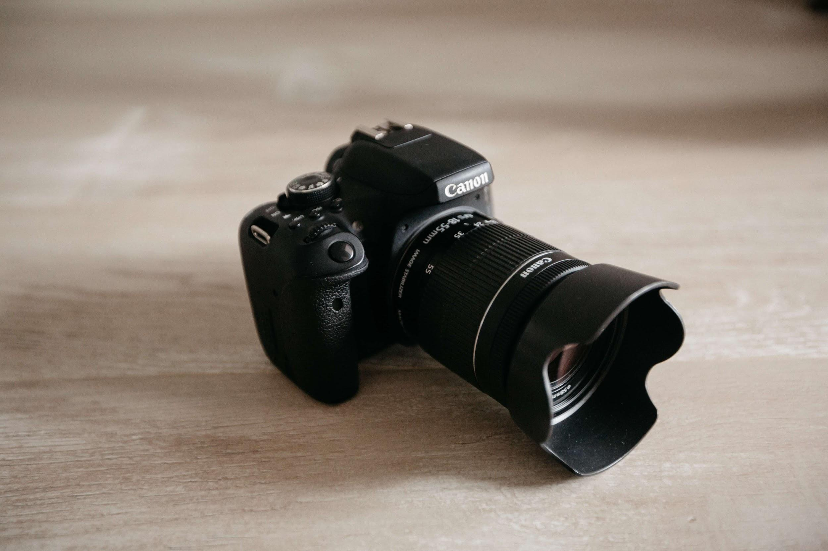
DEMO VIDEO OF OUR
PROJECT

Slide 53


Slide 54
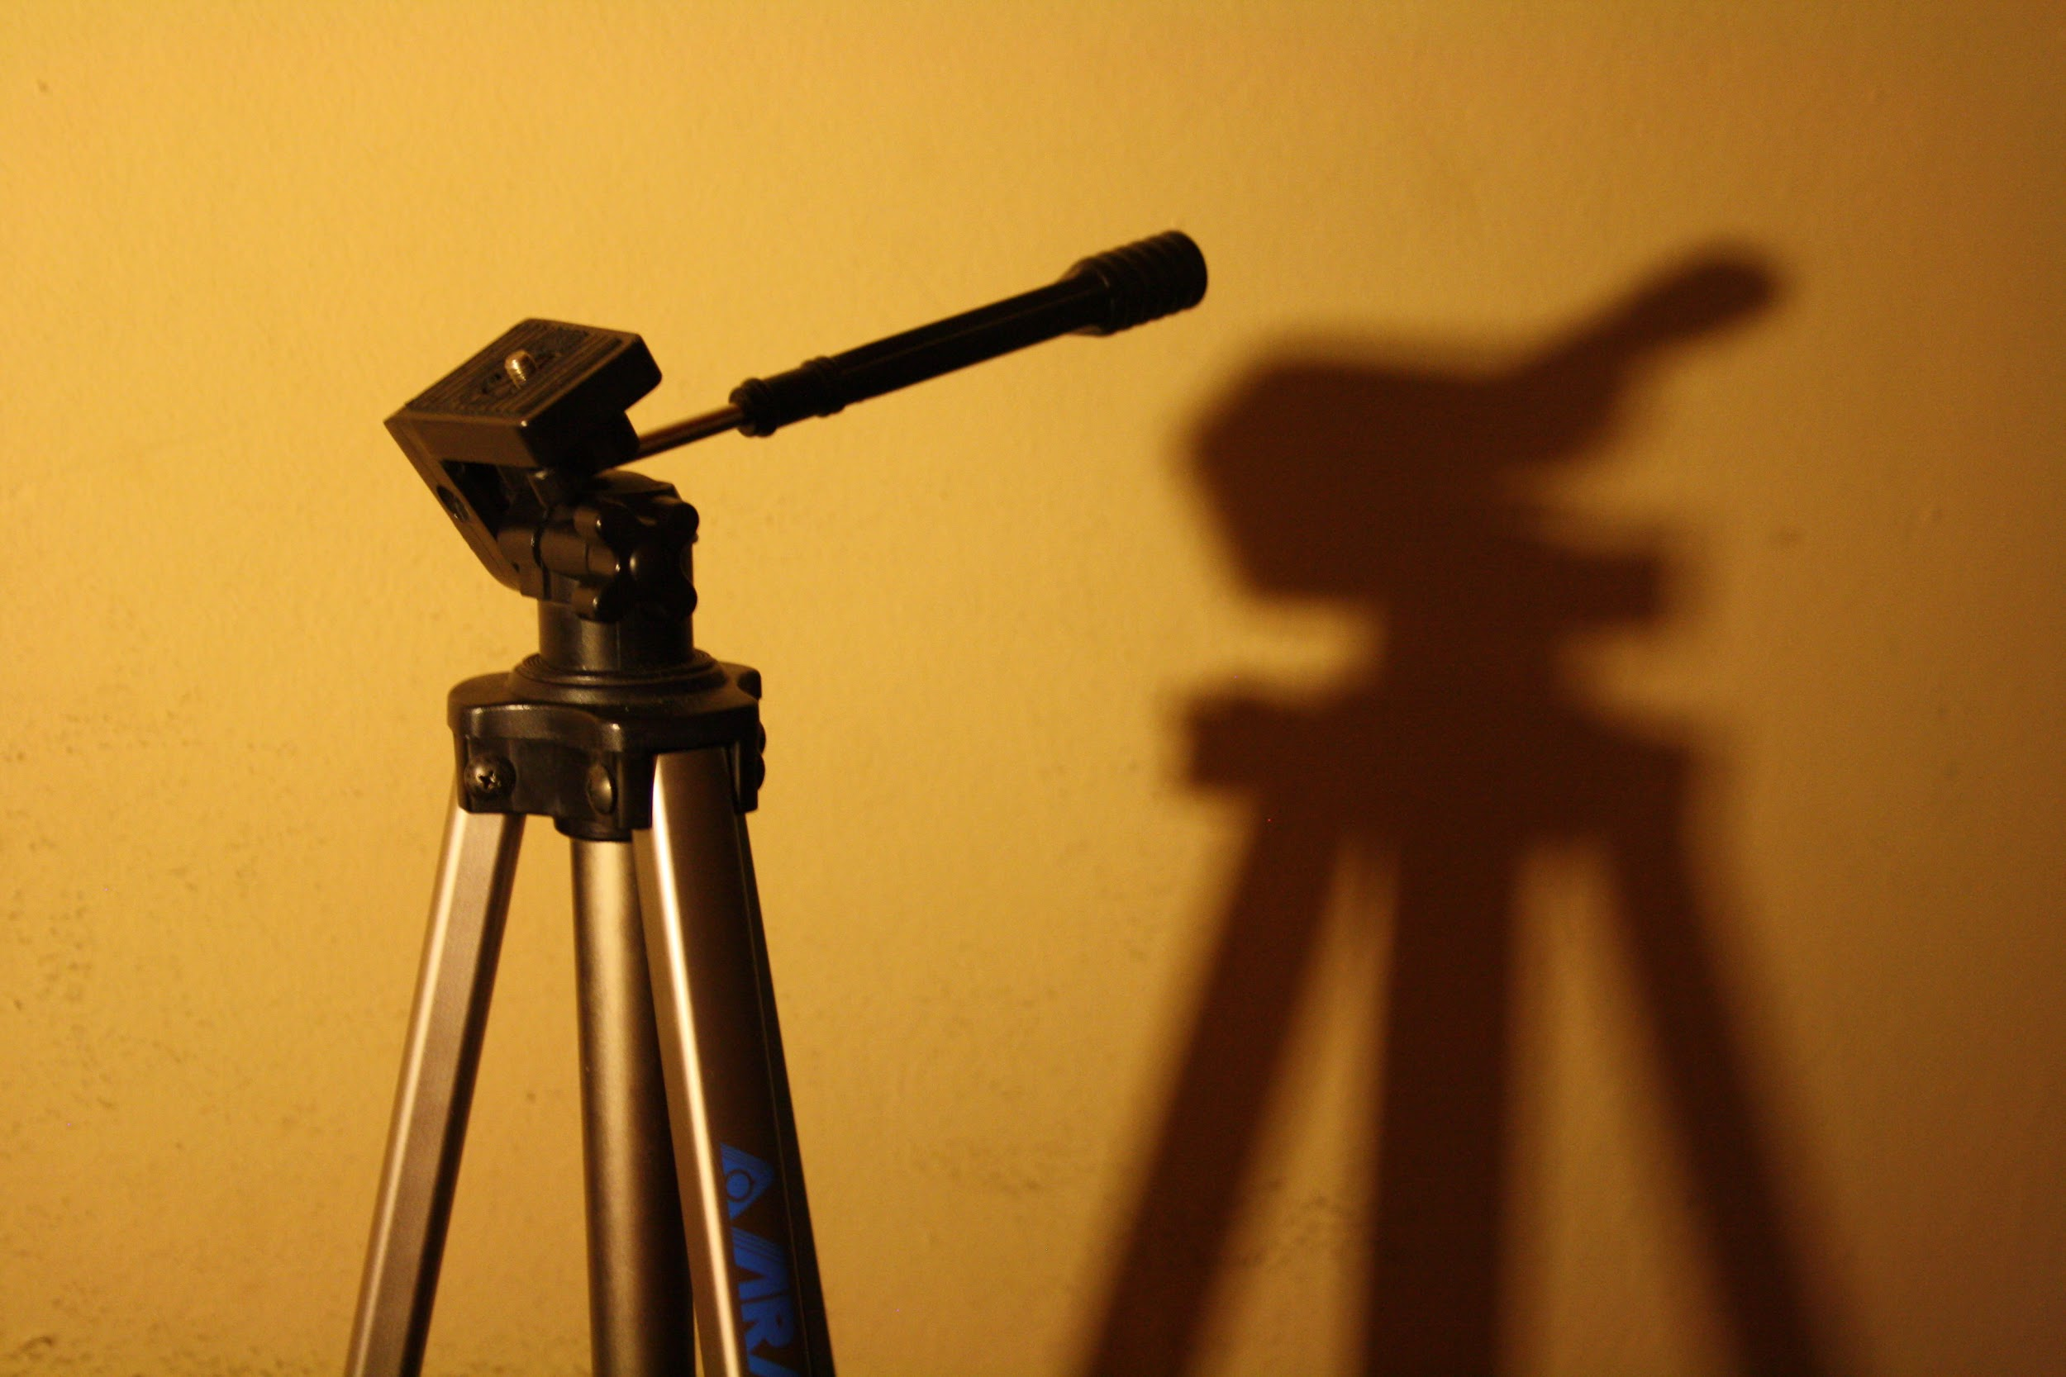
SNAP SHOT
OF OUR
PROJECT (DPad)

Slide 55
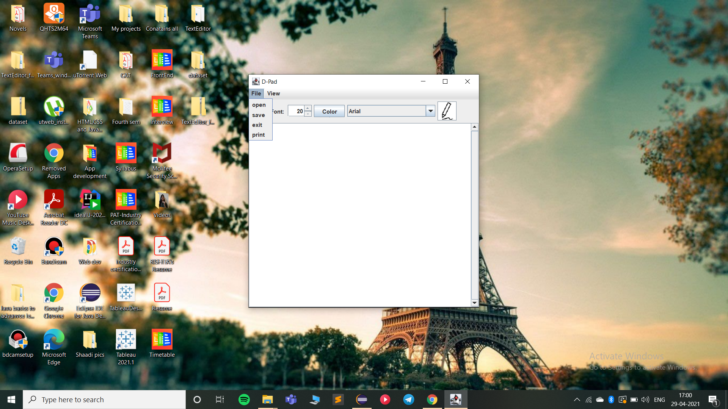
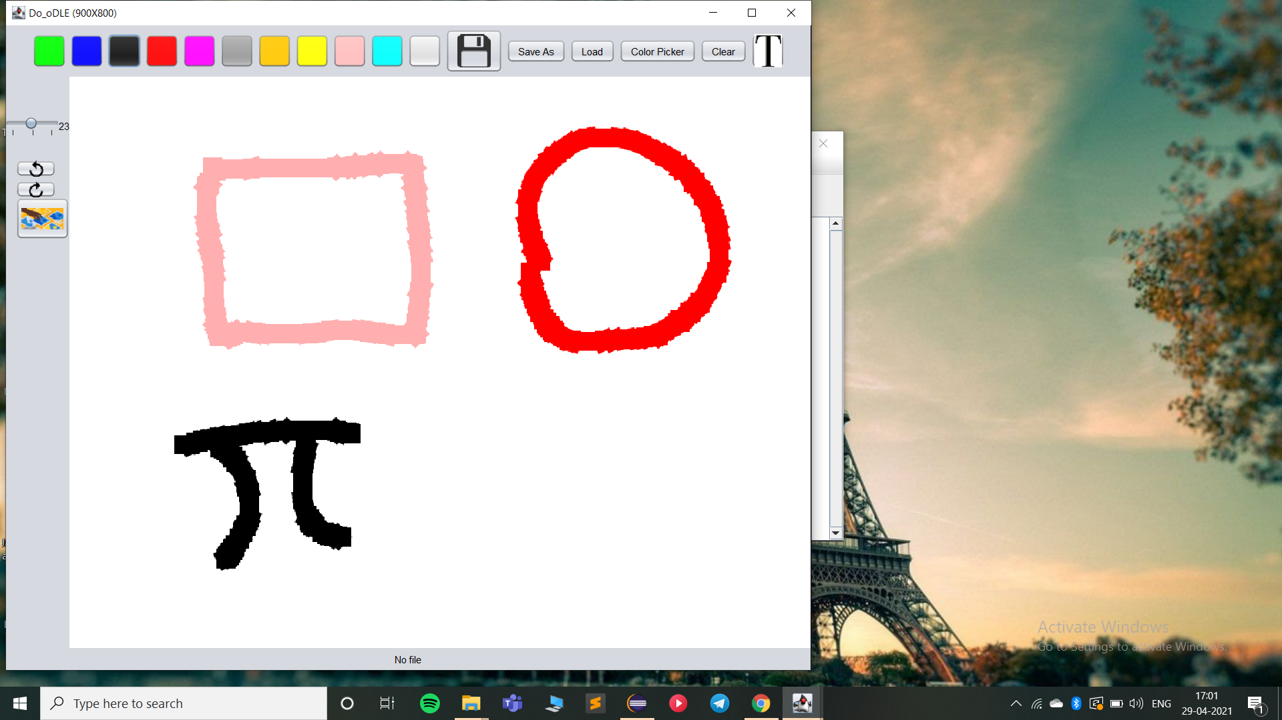

Slide 56
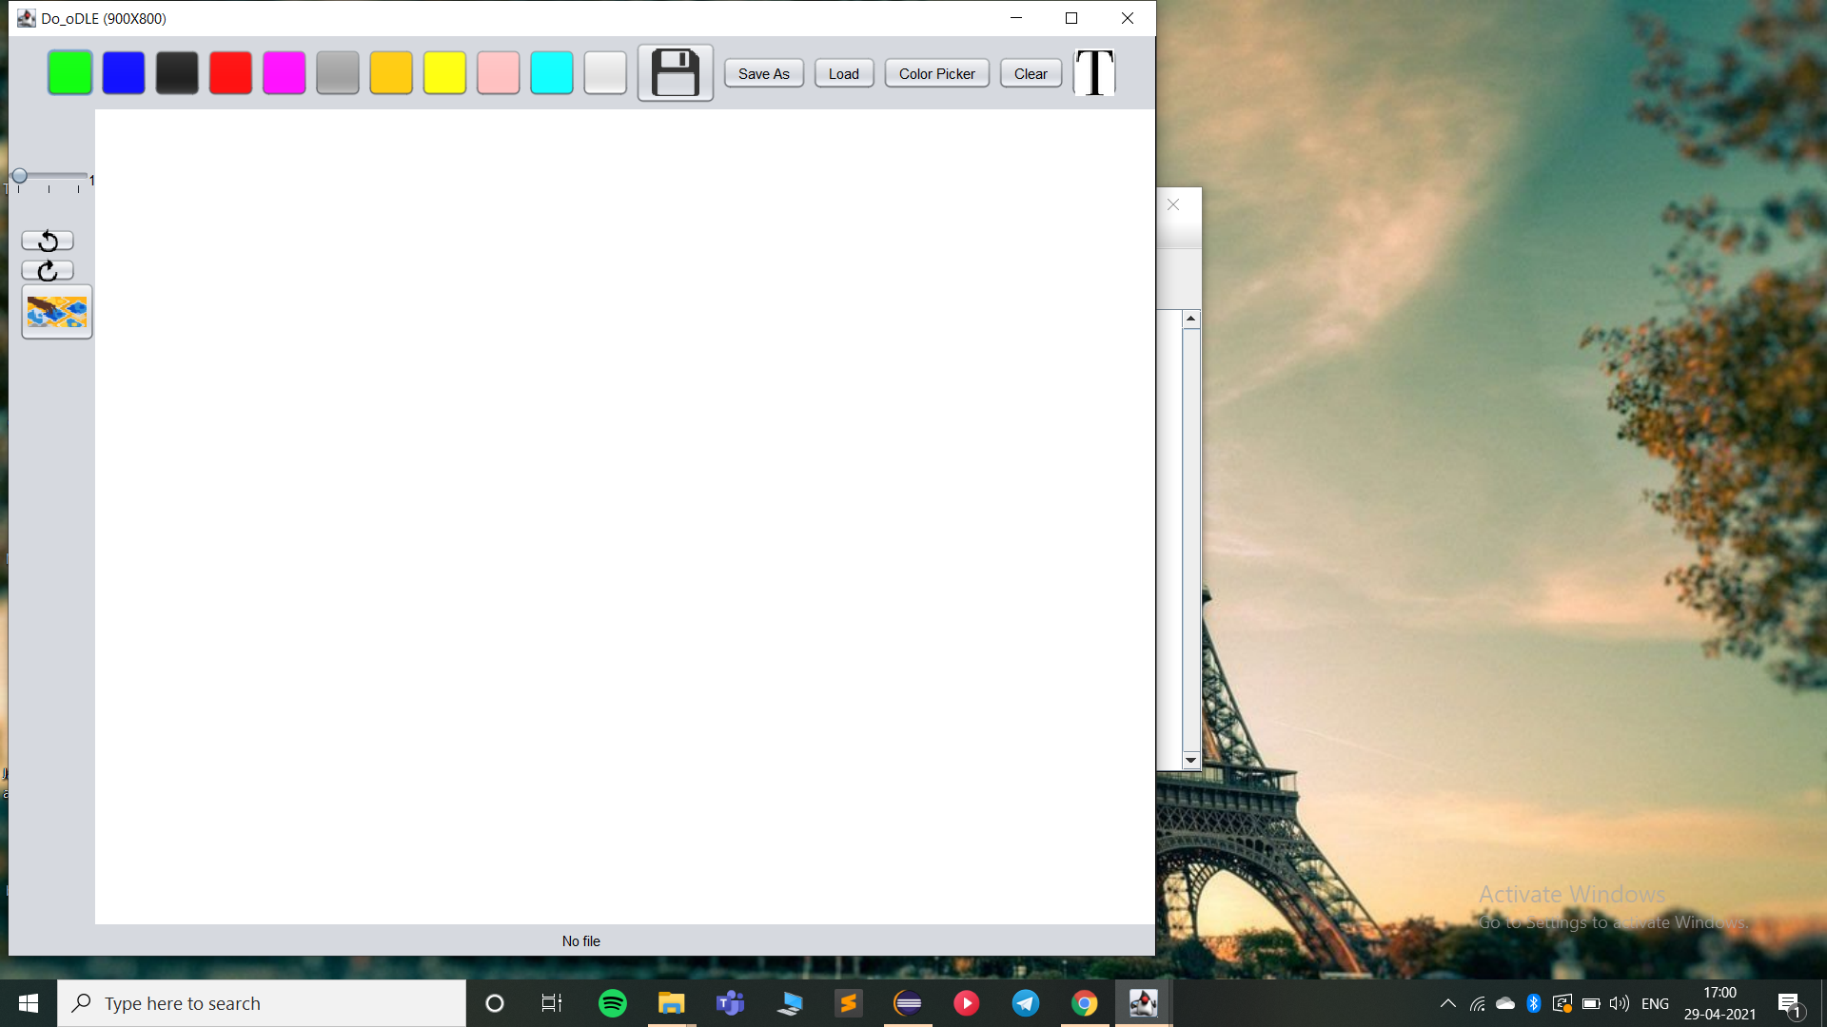
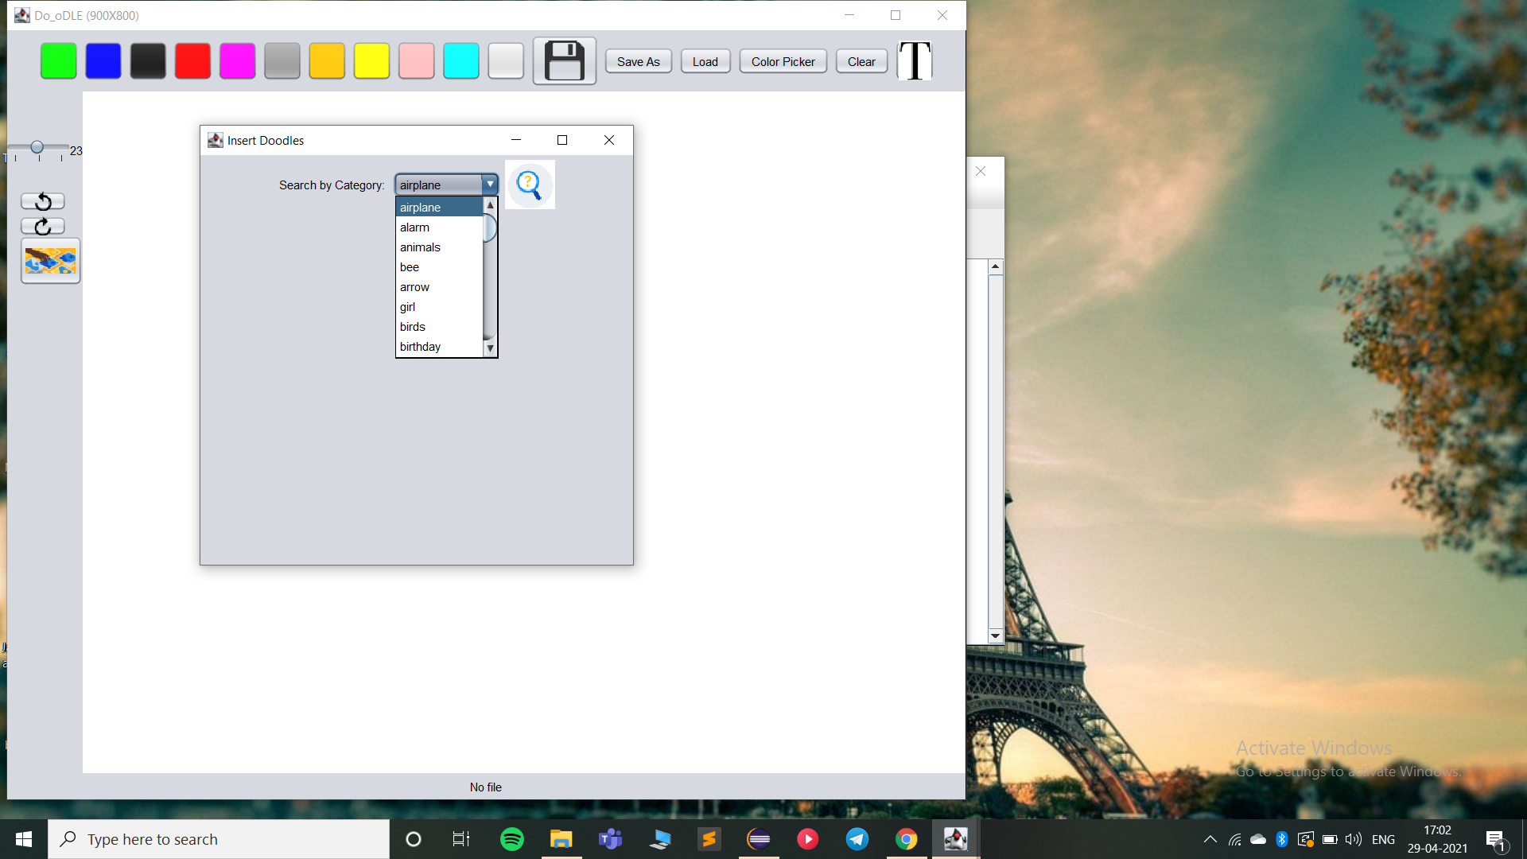

Slide 57
TESTING

Slide 58


Slide 59
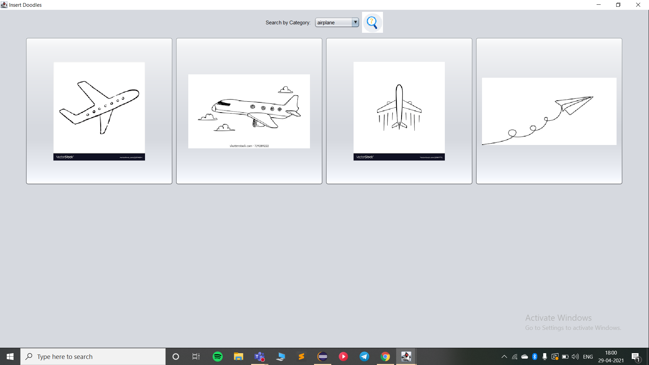

Slide 60
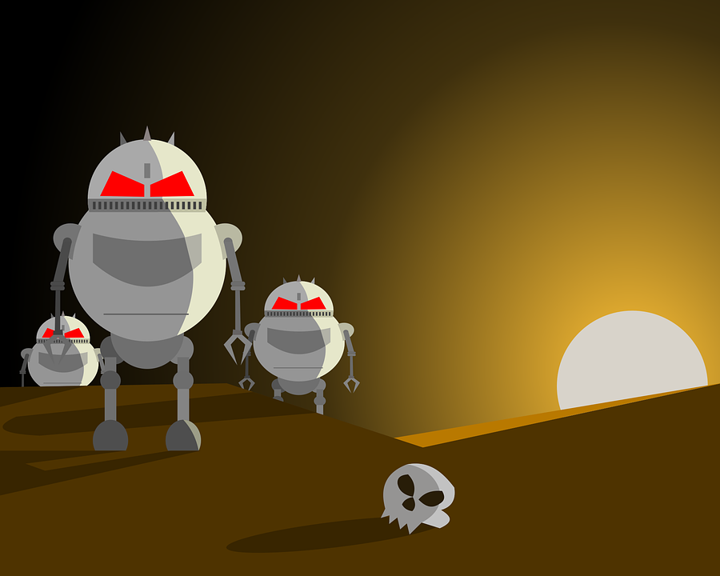
FUTURE
SCOPE
of
PROJECT

Slide 61
This project will largely be used by students because now-a-days,
everyone is attending online classes and meetings and there are times when we cannot write all the points or some symbols such as pi, epsilon, infinity,etc. are not even present on the keyboards.Therefore in such scenarios our project could be a huge breakthrough. We are adding more and more symbols in our dataset for the user’s convenience.

Slide 62


Slide 63
Dpad is a text editor where you get doodling and drawing features along with all the basic features of a text editor such as saving and opening a file,undo,redo, spellcheck and formatting options. We have made the text editor in java using “eclipse”as IDE and concepts of “Data structure and Algorithms” such as “Hash table” and “Gap Buffer” are implemented. Our canvas is created using JFrame.It has various options such as brush size,color palette,undo,redo, etc. Our dataset consists of 40 image set which consists of 4-5 options each.

Slide 64


Slide 65
https://www.geeksforgeeks.org/implement-undo-and-redo-features-of-a-text-editor/
https://www.programmingnotes.org/3144/c-simple-spell-checker-using-a-hash-table
https://www.geeksforgeeks.org/java-swing-jtextarea/
https://www.geeksforgeeks.org/gap-buffer-data-structure/

Slide 66
Thank You!

